Slide 1
Frequencies for 5G
Consultations concerning radio spectrum management

Slide 2
700 MHz – state of play (TV frequency licences)
12 entities (nationwide licences) | MUX1 4 channels from 700 MHz band | ESKA TV (until 2019-05-26) Stavka (until 2021-02-23) Lemon Records (until 2021-02-23) ATM Grupa (until 2021-02-24) LUX Veritatis (until 2023-03-12) Stopklatka (until 2023-09-03) TV Spektrum (until 2023-10-29) TVP (until 2023-11-21)
 | MUX2 5 channels from 700 MHz band | Polsat, TVN, Puls until 2025-07-06
 | MUX3 6 channels from 700 MHz band | TVP until 2023-12-31
700 MHz | MUX4 3 channels from 700 MHz band | INFO-TV-FM until 2023-12-31

Slide 3

700 MHz – our plans
700 MHz
Objective:
release of the 700 MHz frequency band until 2020-06-30
2x30 MHz for PL-wide licences
blocks of 5 MHz or multiple, FDD mode
assignment in a selection procedure
Main activities:
modification of TV frequency licences
international agreements concluded (RU, BY, UA)
arrangments with neighbours concering TV switch-off schedule
Major threats:
lack of compromise with RU regarding TV switch-off
a distant date in the future indicated by BY and UA for TV switch-off
LT and LV declare termination of TV switch-off until 2022
no amendment of the Telecommunications Act and Broadcasting Act

Slide 4
700 MHz – our plans
 | 694-703 |  |  |  |  |  |  |  |  | 703-708 |  |  |  |  | 708-713 |  |  |  |  | 713-718 |  |  |  |  | 718-723 |  |  |  |  | 723-728 |  |  |  |  | 728-733 |  |  |  |  | 733-738 |  |  |  |  | 738-743 |  |  |  |  | 743-748 |  |  |  |  | 748-753 |  |  |  |  | 753-758 |  |  |  |  | 758-763 |  |  |  |  | 763-768 |  |  |  |  | 768-773 |  |  |  |  | 773-778 |  |  |  |  | 778-783 |  |  |  |  | 783-788 |  |  |  |  | 788-791
 | PPDR / PMSE / IoT / SDL
 | Resources for assignment

Slide 5
700 MHz – band release in Europe
 | Finalised
 | Until 2020
 | 2021
 | 2022
 | To be determined
 | No data

Slide 6
3400-3600 MHz – state of play
66 entities 1460 decisions (licences and radio licences) | 28 decisions for local government units | 802 number of municipalities with at least 1 channel occupied
 | 38 decisions for undertakings | 2032-01-31 End of term of the last decision
3400-3600 MHz

Slide 7
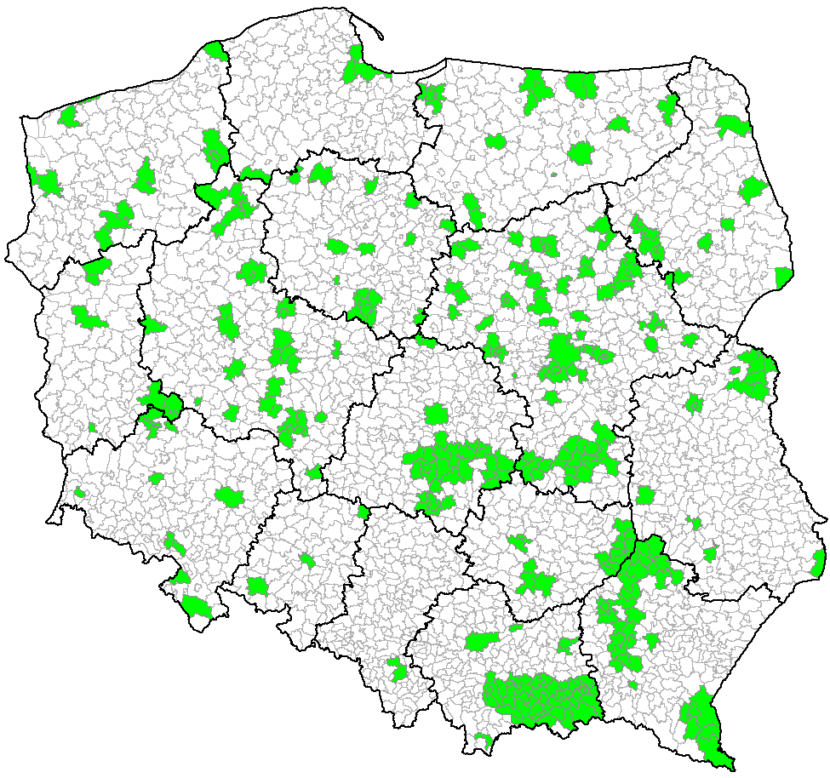
3400-3600 MHz – state of play
 | licences and radio licences

Slide 8
3400-3600 MHz – state of play

Slide 9
3400-3600 MHz – our plans
3400-3600 MHz
Objective:
re-organisation of the occupied band
assignment in a selection procedure
release of at least 150 MHz for 5G (until 2025)
blocks of 5 MHz or multiple, TDD mode
Method:
modification of licences and radio licences
no renewals
band refarming
modification of the frequency management plan (2018/2019)
Current usage:
no new licences or radio licences issued
decisions for tests and experiments

Slide 10
3600-3800 MHz – state of play (nationwide licences)
3 operators (nationwide licences) | T-Mobile 2 licences (2 continuous blocks of 14 MHz) | each valid through 2019-12-29
 | P4 2 licences (2 continuous blocks of 14 MHz)
 | Netia 2 licences (blocks 2x7 MHz) | each valid through 2020-12-31
3600-3800 MHz

Slide 11
3600-3800 MHz – state of play (exNASK licences):
5 entities (500 municipalities in coverage/ 1978 available) | NASK 266 municipalities | 2 licences (blocks 2x7 MHz) 1. licence valid until 2019-12-28 2. licence valid until 2020-12-31
 | INEA 226 municipalities Telbeskid 6 municipalities Miasto Żywiec 1 municipality PPUH NetCenter 1 municipality | 1 licence for each (blocks 2x14 MHz) each valid until 2020-12-31
3600-3800 MHz

Slide 12
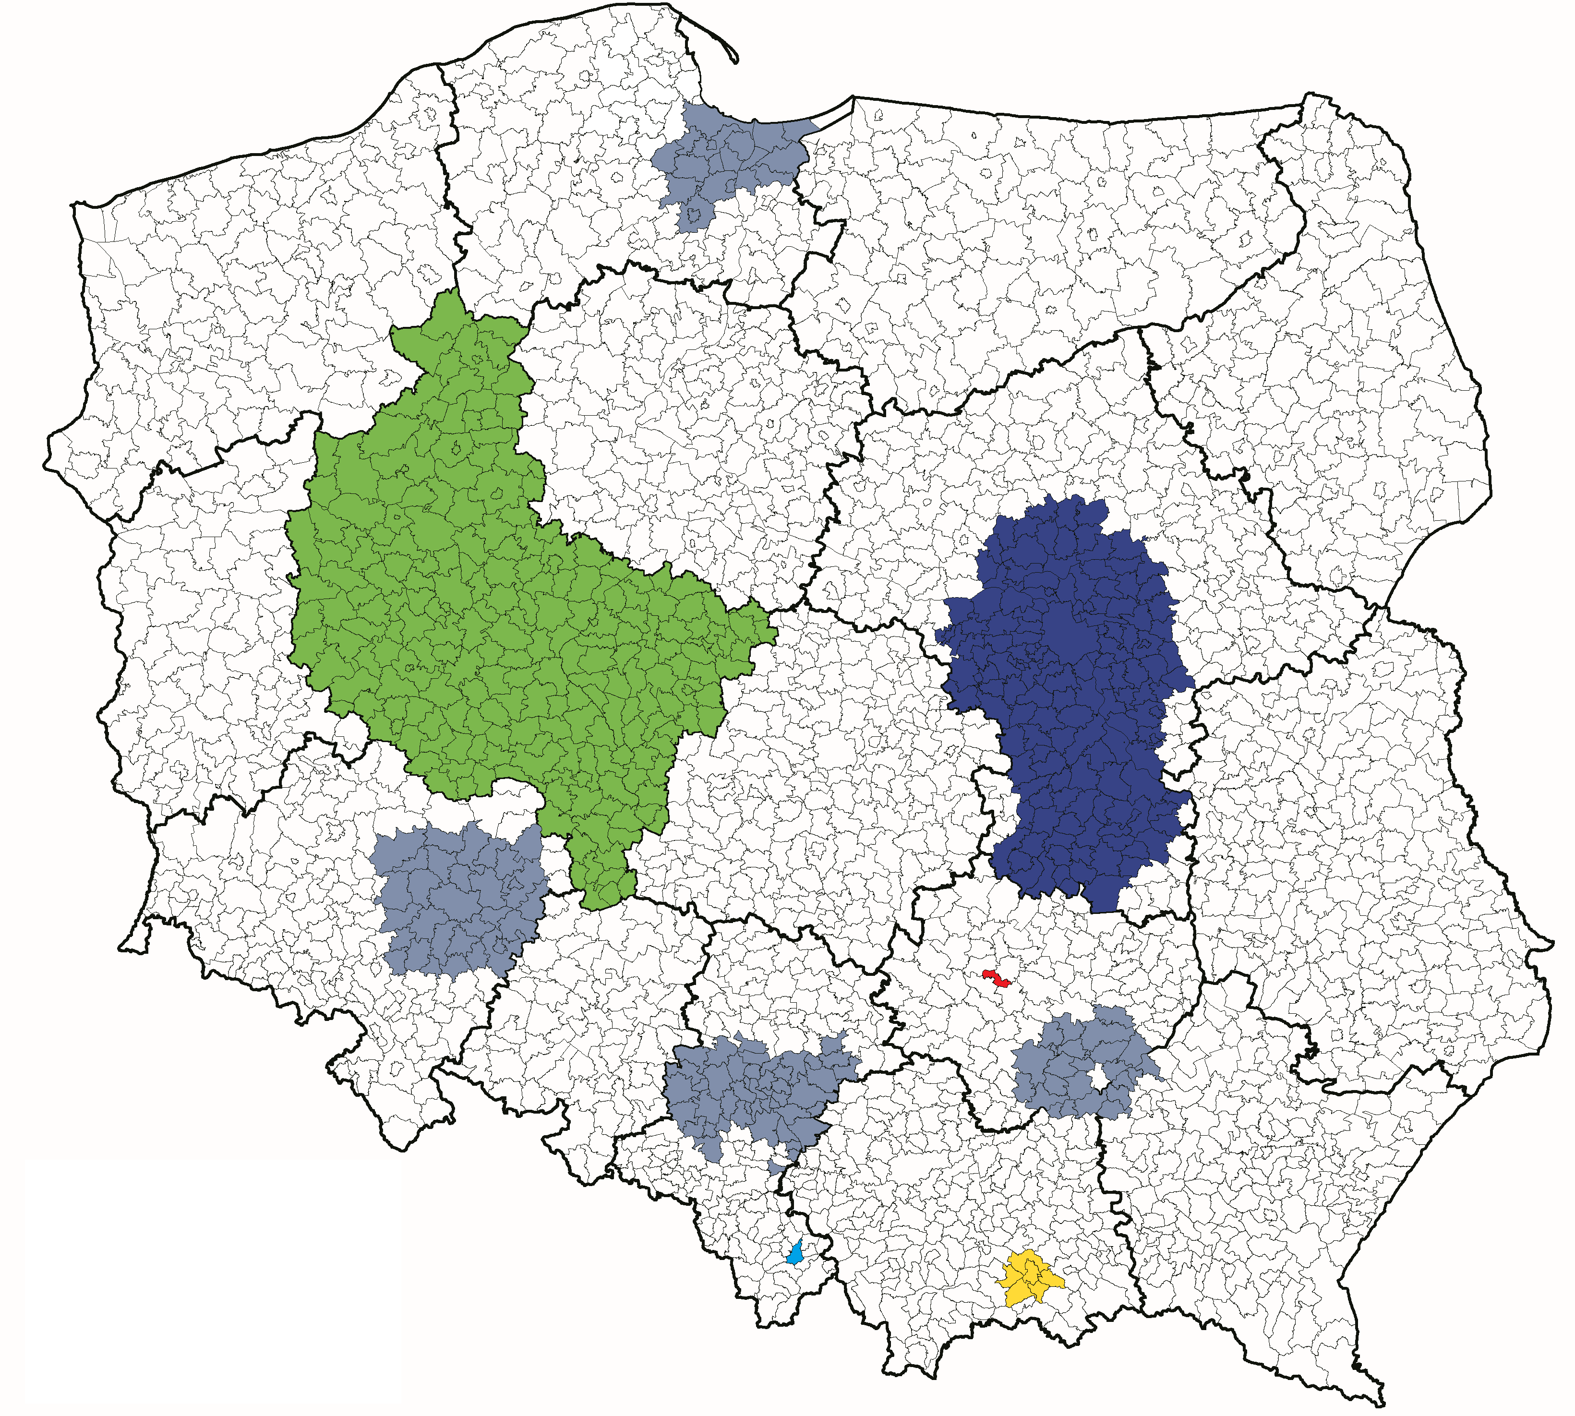
3600-3800 MHz – state of play (exNASK licences):
 | NASK
 | NASK (radio licences)
 | INEA
 | Telbeskid
 | Miasto Żywiec
 | PPUH NetCenter

Slide 13
3600-3800 MHz – state of play (regional licences):
24 entities (35 areas in coverage / 26 available) | 20 licences for local government units | each area = 1 licence (29 licences for 2x14 MHz blocks and 6 licences for 2x10 MHz blocks)
 | 15 licences for undertakings | 34 licences valid until 2022-12-31 1 licence valid until 2022-05-20
3600-3800 MHz

Slide 14
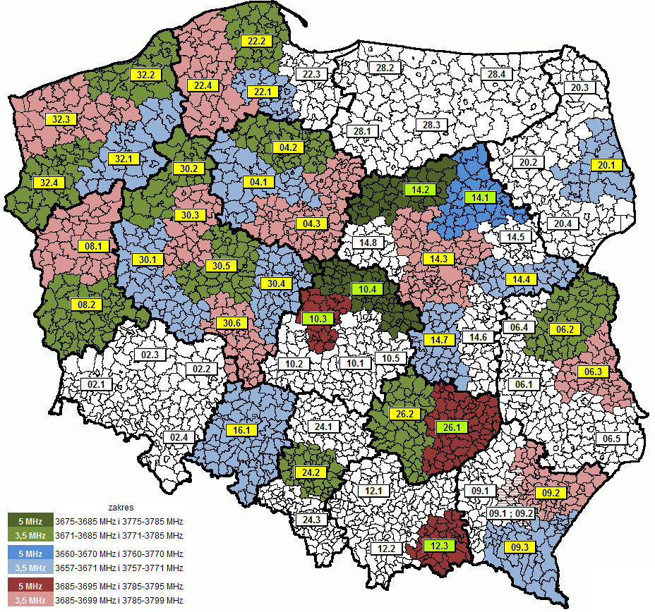
3600-3800 MHz – state of play (regional licences)
04.1 | Woj. Kujawsko-Pomorskie
04.2 | Województwo Kujawsko-Pomorskie
04.3 | Województwo Kujawsko-Pomorskie
06.2 | Powiat Parczewski
06.3 | Powiat Łęczyński
08.1 | Stowarzyszenie Lubuska Sieć Szerokopasmowa
08.2 | Stowarzyszenie „Aglomeracja Zielonogórska”
09.2 | Miasto Rzeszów
09.3 | Gmina Miasto Krosno
14.1 | Gmina Rząśnik
14.4 | Gmina Dobre
14.7 | Powiat Przysuski
20.1 | Miasto Białystok
24.2 | Miasto Gliwice
30.1 | Województwo Wielkopolskie
30.2 | Województwo Wielkopolskie
30.3 | Województwo Wielkopolskie
30.4 | Województwo Wielkopolskie
30.5 | Województwo Wielkopolskie
30.6 | Województwo Wielkopolskie
10.3 | Infratel-Operator Infrastrukturalny sp. z o.o.
10.4 | MPC P. Oleksiewicz
12.3 | Telbeskid sp. z o.o.
14.2 | Raxel Telekom. Mazowiecka S. Owczarczyk
14.3 | P4 sp. z o.o.
16.1 | Netia S.A.
22.1 | Multi-IP Telekomunikacja sp. z o.o.
22.2 | Multi-IP Telekomunikacja sp. z o.o.
22.4 | Multi-IP Telekomunikacja sp. z o.o.
26.1 | IT Partners Telco sp. z o.o
26.2 | Complex Computers sp. z o.o.
32.1 | Espol Sp.z o.o.
32.2 | Espol Sp.z o.o.
32.3 | AS Consulting Sp. z o.o.
32.4 | Espol Sp.z o.o.

Slide 15
3600-3800 MHz – our plans
3600-3800 MHz
Objective:
200 MHz for PL-wide licences
blocks of 5 MHz or multiple, TDD mode
assigment in a selection procedure
until 2023 at the latest
Method:
no licence renewals
exNASK and regional licences refarming
Current usage:
no new licences or radio licences issued
decisions for tests and experiments

Slide 16
3600-3800 MHz – gradual termination of licences
By end of 2019:
 | 3600 MHz |  |  |  |  |  |  |  |  |  |  |  |  | 3800 MHz
 |  | T-Mobile | exNASK | exNASK | Netia |  | regional |  |  | P4 | exNASK | exNASK | Netia |  | regional
Available resources for 5G tests:
10 MHz from exNASK resources (selected localisations out of the 1978 available municipalities) – upper and lower range
Up to 40 MHz from the regional resources (selected localisations in available areas) – upper and lower range

Slide 17
3600-3800 MHz – gradual termination of licences
between 2020-01-01 and 2020-12-31:
 | 3600 MHz |  |  |  |  |  |  |  |  |  |  | 3800 MHz
 | available29 MHz | miscellaneous | exNASK | Netia |  | regional |  | available29 29 MHz | miscellaneous | exNASK | Netia |  | regional
Available resources for 5G tests:
Up to 40 MHz from exT-Mobile and exNASK resources (selected localisations out of the 1978 available municipalities)
Up to 40 MHz from exP4 and exNASK resources (selected localisations out of the 1978 available municipalities)
Up to 40 MHz from the regional resources (selected localisations in available areas) – upper and lower range

Slide 18
3600-3800 MHz – gradual termination of licences
between 2021-01-01 and 2022-12-31:
 | 3600 MHz |  |  |  |  | 3800 MHz
 | available 57 MHz |  | regional |  | available 57 MHz |  | regional
Available resources for 5G tests:
Up to 50 MHz from exT-Mobile, exNASK and exNetii resources (selected localisations in Poland)
Up to 50 MHz from exP4, exNASK and exNetii resources (selected localisations in Poland)
Up to 50 MHz from the regional and exNetii resources (selected localisations in available areas) – upper and lower range

Slide 19
3600-3800 MHz – gradual termination of licences
By 2023-01-01:
 | 3600 MHz |  |  | 3800 MHz
 | 200 MHz available

Slide 20
26 GHz – state of play
51 entities (735 licences and radio licences) | Point-to-Point (Radio Lines) | 8 entities 246 radio licences valid on average until: 2023-07-06
 | Point-to-Multi Point (LMDS) | 43 entities 489 licences and radio licences valid on average until: 2022-06-21
26 GHz

Slide 21
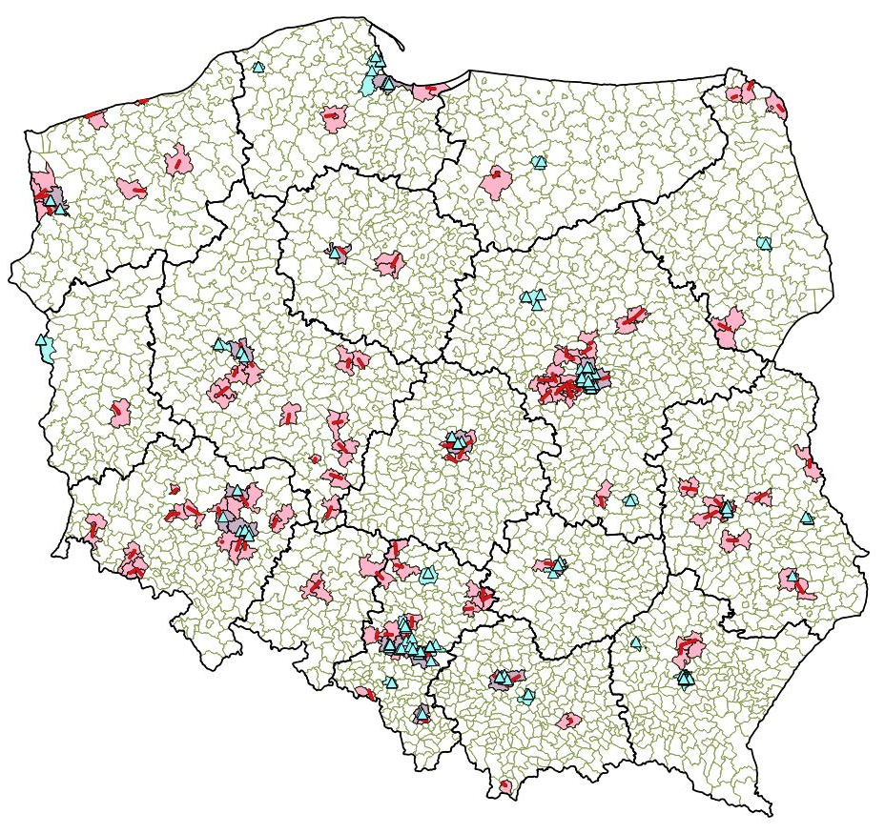
26 GHz – state of play
 | Point-to-Point
 | Point-to-Multi Point

Slide 22
26 GHz – our plans
26 GHz
Objective:
rearranging of the occupied band
release of resources for 5G
Method:
modification of licences and radio licences
band refarming and reshuffling
taking over frequencies held by MoND
modification of the frequency management plan
Current usage:
decisions for limited terms and resources

Slide 23
26 GHz – planned actions
State of play:
24,25 GHz |  |  |  |  |  |  |  |  |  |  |  |  |  |  |  |  |  |  |  |  |  |  |  |  |  |  |  |  |  |  |  |  |  |  |  |  |  |  |  |  |  |  |  |  |  |  |  |  |  |  |  |  |  |  |  |  | 25,5 GHz |  |  |  |  |  |  |  |  |  |  |  |  |  |  |  |  |  |  |  |  |  |  |  |  |  |  |  |  |  |  |  |  |  |  |  |  |  |  |  |  |  |  |  |  |  |  |  |  | 26,6 GHz |  |  |  |  |  |  |  |  |  |  |  |  |  |  |  |  |  |  |  |  |  |  |  |  |  |  |  |  |  |  |  |  |  | 27,5 GHz
civil |  |  |  |  |  |  |  |  |  |  |  |  |  |  |  |  |  |  |  |  |  |  |  |  |  |  |  |  |  |  |  |  |  |  |  |  |  |  |  |  |  |  |  |  |  |  |  |  |  |  |  |  |  |  |  |  |  |  |  |  |  |  | civil |  |  |  |  |  |  |  |  |  |  |  |  |  |  |  |  |  |  |  |  |  |  |  |  |  |  |  |  |  |  |  |  |  |  |  |  |  |  |  |  |  |  |  |  |  |  |  |  |  | MoND

Slide 24
26 GHz – planned actions
Future channel arrangement:
24.25 GHz |  |  |  |  |  |  |  |  |  |  |  |  |  |  |  |  |  |  |  |  |  |  |  |  |  |  |  |  |  |  |  |  |  |  |  |  |  |  |  |  |  |  |  |  |  |  |  | 25.5 GHz |  |  |  |  |  |  |  |  |  |  |  |  |  |  |  |  |  |  |  |  |  |  |  |  |  |  |  |  |  |  |  |  |  | 26.6 GHz |  |  |  |  |  |  |  |  |  |  |  |  |  |  |  |  |  |  |  |  |  |  | 27.5 GHz
 |  |  | 200 |  | 200 |  |  |  |  |  |  |  |  |  | 200 |  |  |  |  |  |  |  |  |  | 200 |  |  |  |  |  |  |  |  |  | 200 |  |  |  |  |  |  |  |  |  | 200 |  |  |  | 200 | 200 |  |  |  |  |  |  |  |  |  | 200 |  |  |  |  |  |  |  |  |  | 200 |  |  |  |  |  |  |  |  |  | 200 |  |  | 200 |  |  |  |  |  | 200 |  |  |  |  |  |  |  |  |  | 200 |  |  |  |  |  |  | 200 | 200
 |  |  | 24.3 GHz

Slide 25
26 GHz – planned actions
Migration:
24.25 GHz |  |  |  |  |  |  |  |  |  |  |  |  |  |  |  |  |  |  |  |  |  |  |  |  |  |  |  |  |  |  |  |  |  |  |  |  |  |  |  |  | 25.5 GHz |  |  |  |  |  |  |  |  |  |  |  |  |  |  |  |  |  |  |  |  |  |  |  |  |  |  |  |  |  |  |  |  |  | 26.6 GHz |  |  |  |  |  |  |  |  |  |  |  |  |  |  |  |  |  |  |  |  |  |  | 27.5 GHz
 |  |  | 200 |  | 200 |  |  | 200 |  |  |  |  |  |  |  |  |  | 200 |  |  |  |  |  |  |  |  |  | 200 |  |  |  |  |  |  |  |  |  | 200 |  |  |  | 200 | 200 |  |  |  |  |  |  |  |  |  | 200 |  |  |  |  |  |  |  |  |  | 200 |  |  |  |  |  |  |  |  |  | 200 |  |  | 200 |  |  |  |  |  | 200 |  |  |  |  |  |  |  |  |  | MoND
 |  |  | 24.3 GHz
 | Allocation negotiations with MoND
 | Current systems
 | Available after reshuffling

Slide 26
Available for tests (selected locations)
No. | City / town | 26 GHz | 3.7 GHz | 3.5 GHz | 700 MHz | Available resources in total [MHz]
1 | Koszalin | 2x889 MHz | 2x42 MHz | 2x87,5 MHz |  | 2037
2 | Olsztyn | 2x826 MHz | 2x56 MHz | 2x70 MHz |  | 1904
3 | Białystok | 2x854 MHz | 2x42 MHz | 2x14 MHz |  | 1820
4 | Bydgoszcz | 2x749 MHz | 2x42 MHz | 2x45 MHz |  | 1672
5 | Toruń | 2x672 MHz | 2x42 MHz | 2x35 MHz |  | 1498
6 | Kielce | 2x504 MHz | 2x28 MHz |  |  | 1064
7 | Opole | 2x406 MHz | 2x42 MHz | 2x10,5 MHz |  | 917
8 | Lublin | 2x350 MHz | 2x42 MHz | 2x63 MHz |  | 910
9 | Zielona Góra | 2x378 MHz | 2x42 MHz | 2x28 MHz |  | 896
10 | Gorzów Wlkp. | 2x378 MHz | 2x42 MHz | 2x7 MHz |  | 854
 | Frequency allocation in discontinuous blocks
 | Frequencies with interferences
Data as of: 20.05.2018

Slide 27
Available for tests (selected locations)
Nr | City / town | 26 GHz | 3.7 GHz | 3.5 GHz | 700 MHz | Available resources in total [MHz]
11 | Szczecin | 2x350 MHz | 2x42 MHz |  |  | 784
12 | Częstochowa | 2x336 MHz | 2x28 MHz | 2x24,5 MHz |  | 777
13 | Poznań | 2x336 MHz |  | 2x21 MHz |  | 714
14 | Wrocław | 2x259 MHz | 2x42 MHz | 2x42 MHz |  | 686
15 | Rzeszów | 2x224 MHz | 2x42 MHz |  |  | 532
16 | Łódź | 2x154 MHz | 2x42 MHz | 2x63 MHz | 2x5 MHz | 528
17 | Gdańsk | 2x231 MHz | 2x28 MHz |  |  | 518
18 | Kraków | 2x168 MHz | 2x42 MHz |  | 2x5 MHz | 430
19 | Katowice |  | 2x28 MHz | 2x42 MHz |  | 140
20 | Warszawa |  | 2x28 MHz | 2x24,5 MHz |  | 105
 | Frequency allocation in discontinuous blocks
 | Frequencies with interferences
 | Possible interferences from BY (Łódź) or CZ (Kraków) for the sixth LTE block
Data as of: 20.05.2018

Slide 28
Questions
1 | Pilot projects 1.1. Should pilot projects be launched in one or many municipalities, or some other area (if so, please specify)? 1.2. What are operators’ views on pilot projects being conducted until 2020? 1.3. On what terms and conditions would your entity willing to launch a pilot project?
2 | 5G network development model 2.1. What is the preferred model for 5G network development (one network, numerous networks, or maybe further development of the existing infrastructure)?
3 | Frequencies 3.1. What should be the order of band assignment? 3.2. Should some of the bands be assigned jointly (e.g. 3.7 GHz with 26 GHz), or separately? 3.3. Should frequency licences be granted at the national, regional or local level? 3.4. What should be the minimal widths of frequency blocks for the individual bands? 3.5. What should be the maximum width of a block granted to a single entity?
4 | Other bands 4.1. Should other bands be considered for the 5G network too (in particular 1427-1518 MHz, 2300-2400 MHz, 3800-4200 MHz, 26.5-27.5 GHz)?

Slide 29
Abbreviations
26 GHz | 24.25-27.5 GHz
700 MHz | 694-790 MHz
BY | Republic of Belarus
CZ | Czech Republic
FDD | Frequency Division Duplex
IoT | Internet of Things
LMDS | Local Multipoint Distribution Services
LTE | Long Term Evolution
LT | Republic of Lithuania
LV | Republic of Latvia
MoND | Polish Ministry of National Defence
MUX | Multiplex
pilot project | 5G network launch based on the resources already held by the operators and resources handed over for tests
PMSE | Programme Making and Special Events
PPDR | Public Protection & Disaster Relief
PL | Republic of Poland
RU | Russian Federation
SDL | Supplemental Downlink
TDD | Time Division Duplex
TV | television
UA | Ukraine

